Slide 1
Chapter 18
Testing Conventional Applications
Slide Set to accompany
Software Engineering: A Practitioner’s Approach, 7/e
by Roger S. Pressman
Slides copyright © 1996, 2001, 2005, 2009 by Roger S. Pressman
For non-profit educational use only
May be reproduced ONLY for student use at the university level when used in conjunction with Software Engineering: A Practitioner's Approach, 7/e. Any other reproduction or use is prohibited without the express written permission of the author.
All copyright information MUST appear if these slides are posted on a website for student use.
These slides are designed to accompany Software Engineering: A Practitioner’s Approach, 7/e (McGraw-Hill 2009). Slides copyright 2009 by Roger Pressman.

Slide 2
Testability
Operability—it operates cleanly
Observability—the results of each test case are readily observed
Controllability—the degree to which testing can be automated and optimized
Decomposability—testing can be targeted
Simplicity—reduce complex architecture and logic to simplify tests
Stability—few changes are requested during testing
Understandability—of the design
These slides are designed to accompany Software Engineering: A Practitioner’s Approach, 7/e (McGraw-Hill 2009). Slides copyright 2009 by Roger Pressman.

Slide 3
What is a “Good” Test?
A good test has a high probability of finding an error
A good test is not redundant.
A good test should be “best of breed”
A good test should be neither too simple nor too complex
These slides are designed to accompany Software Engineering: A Practitioner’s Approach, 7/e (McGraw-Hill 2009). Slides copyright 2009 by Roger Pressman.

Slide 4
Test Case Design
"Bugs lurk in corners
and congregate at
boundaries ..."
Boris Beizer
OBJECTIVE
to cover errors
CRITERIA
in a complete manner
CONSTRAINT
with a minimum of effort and time
These slides are designed to accompany Software Engineering: A Practitioner’s Approach, 7/e (McGraw-Hill 2009). Slides copyright 2009 by Roger Pressman.

Slide 5
Software Testing
white-box
methods
black-box
methods
Methods
Strategies
These slides are designed to accompany Software Engineering: A Practitioner’s Approach, 7/e (McGraw-Hill 2009). Slides copyright 2009 by Roger Pressman.

Slide 6

White-Box Testing
... our goal is to ensure that all
statements and conditions have
been executed at least once ...
These slides are designed to accompany Software Engineering: A Practitioner’s Approach, 7/e (McGraw-Hill 2009). Slides copyright 2009 by Roger Pressman.

Slide 7
Why Cover?
logic errors and incorrect assumptions
are inversely proportional to a path's
execution probability
we often
believe
that a path is not
likely to be executed; in fact, reality is
often counter intuitive
typographical errors are random; it's
likely that untested paths will contain
some
These slides are designed to accompany Software Engineering: A Practitioner’s Approach, 7/e (McGraw-Hill 2009). Slides copyright 2009 by Roger Pressman.

Slide 8
Basis Path Testing
The basis path method enables to derive a logical complexity measure of a procedural design
defining a basis set of execution paths .
These slides are designed to accompany Software Engineering: A Practitioner’s Approach, 7/e (McGraw-Hill 2009). Slides copyright 2009 by Roger Pressman.

Slide 9
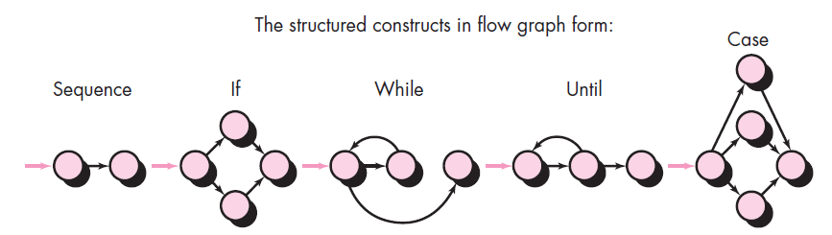
Flow graph notation
Arrows called edges represent flow of control
Circles called nodes represent one or more actions.
Areas bounded by edges and nodes called regions.
A predicate node is a node containing a condition.
These slides are designed to accompany Software Engineering: A Practitioner’s Approach, 7/e (McGraw-Hill 2009). Slides copyright 2009 by Roger Pressman.

Slide 10
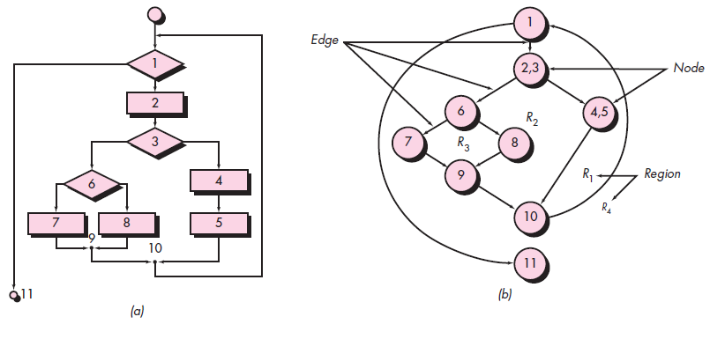
a) Flowchart and (b) flow graph
These slides are designed to accompany Software Engineering: A Practitioner’s Approach, 7/e (McGraw-Hill 2009). Slides copyright 2009 by Roger Pressman.

Slide 11
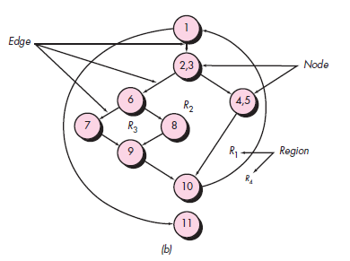
Basis Path Testing
Next, we derive the
independent paths:
Since V(G) = 4,
there are four paths
Path 1: 1-11
Path 2: 1-2-3-4-5-10-1-11
Path 3: 1-2-3-6-8-9-10-1-11
Path 4: 1-2-3-6-7-9-10-1-11
Finally, we derive test
cases to exercise these
paths.
These slides are designed to accompany Software Engineering: A Practitioner’s Approach, 7/e (McGraw-Hill 2009). Slides copyright 2009 by Roger Pressman.

Slide 12
Basis Path Testing Notes
you don't need a flow chart,
but the picture will help when
you trace program paths
count each simple logical test,
compound tests count as 2 or
more
basis path testing should be
applied to critical modules
These slides are designed to accompany Software Engineering: A Practitioner’s Approach, 7/e (McGraw-Hill 2009). Slides copyright 2009 by Roger Pressman.

Slide 13
Cyclomatic Complexity
Cyclomatic complexity is a software metric that provides
a quantitative measure of the logical complexity of a program.
A number of industry studies have indicated that the higher
V(G), the higher the probability or errors
modules
V(G)
modules in this range are
more error prone
These slides are designed to accompany Software Engineering: A Practitioner’s Approach, 7/e (McGraw-Hill 2009). Slides copyright 2009 by Roger Pressman.

Slide 14
Cyclomatic Complexity
1. The number of regions of the flow graph corresponds to the cyclomatic complexity.
2. Cyclomatic complexity V(G) for a flow graph G is defined as
V(G) = E - N + 2
where E is the number of flow graph edges and N is the number of flow graph nodes.
3. Cyclomatic complexity V(G) for a flow graph G is also defined as
V(G) = P + 1
where P is the number of predicate nodes contained in the flow graph G.
These slides are designed to accompany Software Engineering: A Practitioner’s Approach, 7/e (McGraw-Hill 2009). Slides copyright 2009 by Roger Pressman.

Slide 15
Cyclomatic Complexity
1. The flow graph has four regions.
2. V(G) = 11 edges - 9 nodes + 2 = 4.
3. V(G) = 3 predicate nodes + 1 = 4.
These slides are designed to accompany Software Engineering: A Practitioner’s Approach, 7/e (McGraw-Hill 2009). Slides copyright 2009 by Roger Pressman.

Slide 16
Black-Box Testing
requirements
output
input
events
These slides are designed to accompany Software Engineering: A Practitioner’s Approach, 7/e (McGraw-Hill 2009). Slides copyright 2009 by Roger Pressman.

Slide 17
Black-box Testing
Focus: I/O behavior. If for any given input, we can predict the output, then the module passes the test.
  Almost always impossible to generate all possible inputs ("test cases")
Goal: Reduce number of test cases by equivalence partitioning:
  Divide input conditions into equivalence classes
  Choose test cases for each equivalence class.
What would be the equivalence classes?

Slide 18
Black-box Testing (Continued)
Selection of equivalence classes (No rules, only guidelines):
  Input is valid across range of values. Select test cases from 3 equivalence classes:
    Below the range
    Within the range
    Above the range
  Input is valid if it is from a discrete set. Select test cases from 2 equivalence classes:
    Valid discrete value
    Invalid discrete value
Another solution to select only a limited amount of test cases:
  Get knowledge about the inner workings of the unit being tested => white-box testing
Are these complete?

Slide 19
Equivalence partitioning
Input data and output results often fall into different classes where all members of a class are related
Each of these classes is an equivalence partition where the program behaves in an equivalent way for each class member
Test cases should be chosen from each partition

Slide 20
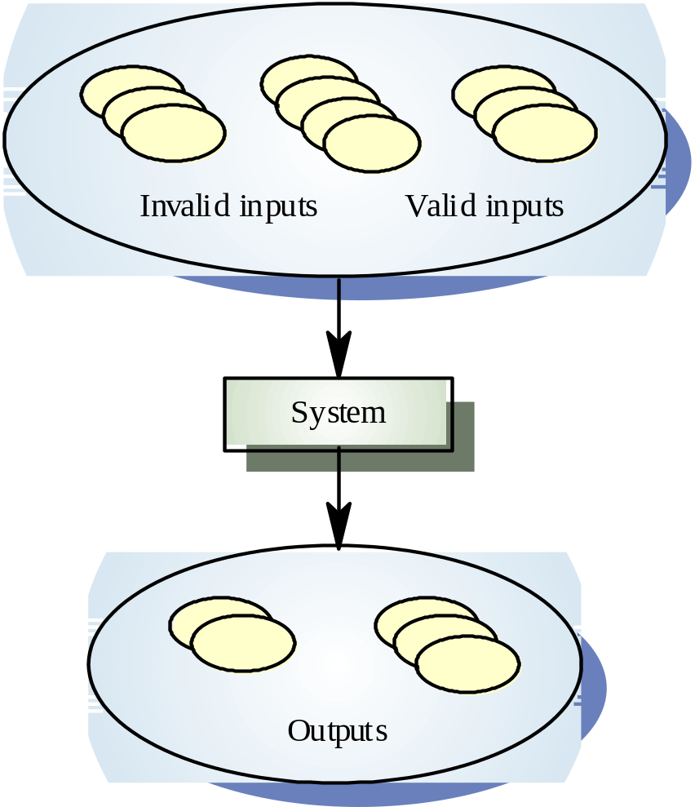
Equivalence partitioning

Slide 21
Equivalence partitioning
Partition system inputs and outputs into
‘equivalence sets’
  If input is a 5-digit integer between 10,000 and 99,999,
  equivalence partitions are <10,000, 10,000-99, 999 and >10, 000
Choose test cases at the boundary of these
sets
  00000, 09999, 10000, 99999, 10001

Slide 22
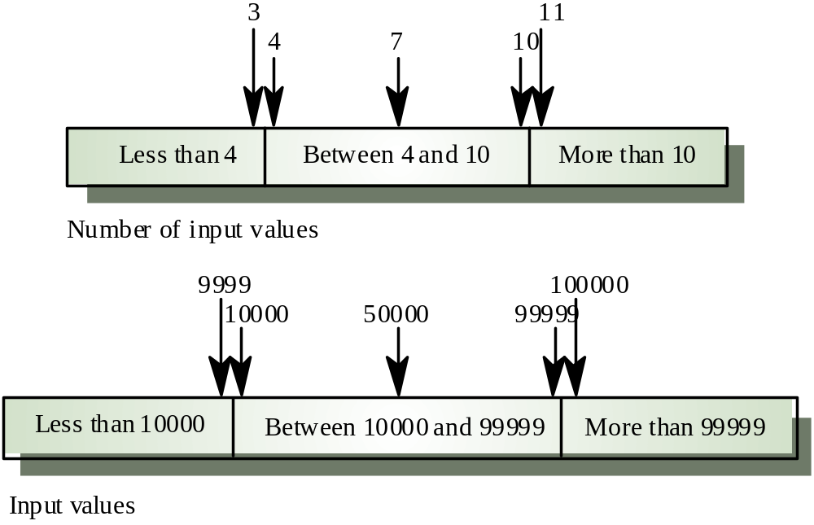
Equivalence partitions

Slide 23
Equivalence partitioning example
Example of a function which takes a parameter “month”.
The valid range for the month is 1 to 12, representing January to December. This valid range is called a partition.
In this example there are two further partitions of invalid ranges.
x < 1
1 ≤ x ≤ 12
12 < x

Slide 24
Equivalence partitioning example
Test cases are chosen so that each partition would be tested.
-2
5
17
x < 1
1 ≤ x ≤ 12
12 < x

Slide 25
Boundary value analysis
Equivalence partitioning is not a stand alone method to determine test cases. It is usually supplemented by boundary value analysis.
Boundary value analysis focuses on values on the edge of an equivalence partition or at the smallest value on either side of an edge.

Slide 26
Equivalence partitioning with boundary value analysis
We use the same example as before.
Test cases are supplemented with boundary values.
-2
1
5
12
17
0
2
11
13
x < 1
1 ≤ x ≤ 12
12 < x

